Slide 1
Lane County Homeless System and Shelter Feasibility Study: Analysis of Need, System Map, and Preliminary Findings
Technical Assistance Collaborative
October 10, 2018

Slide 2
Objectives for this Presentation
Overview of homelessness in Lane County
System Map
Challenges facing Lane County
Preliminary Recommendations
System Modeling
Notes:
We will introduce ourselves, and say a little something about TAC

Slide 3
Who is Homeless in Lane County

Slide 4
2018 Point in Time Count (PIT) All Homeless Persons
Notes:
Lane County 2018 Final PIT count (provided by Lane County)
The Point in Time or PIT is a count on a single night, typically the last Wednesday in the month of January, where all the unsheltered, sheltered, and TH projects count the number of people who are homeless that night. It’s a snap shot of one night. CoCs all around the country are doing the PIT the same week in January. Also describe “annualized” homeless count numbers. The annualized number of homeless people counts all the people who have been homeless in your system for a year (or longer but we’ll say if it’s more than a year). It looks at all the people in your system over the course of that year as well as counting all who are new/entering your system. We look at different numbers for different reasons when analyzing data, we will be clear which one we’re talking about- PIT or Annualized numbers throughout this presentation and the report

Slide 5
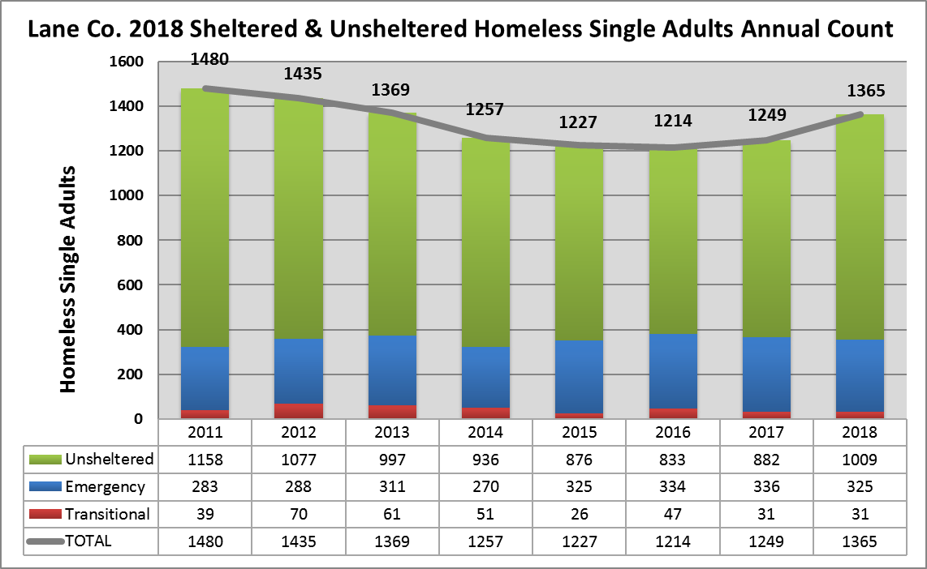
2018 PIT- Homeless Single Adults
Notes:
* Lane County 2018 PIT county (provided by Lane County)

Slide 6
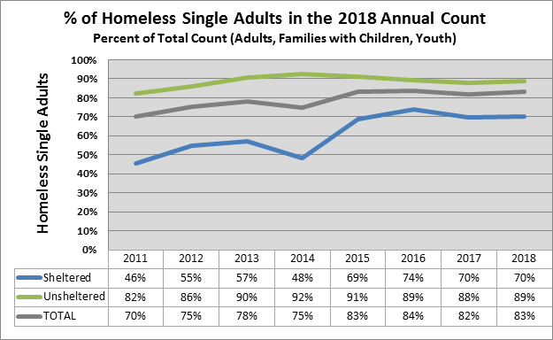
Percentage of People Who Are Homeless Single Adults
Notes:
Lane County 2018 Final PIT count (provided by Lane County)
Trending wise since 2010 the percentage of single adults who are part of the overall homeless population has increased steadily
As of 2018 single adults make up 83% of the total homeless population and 89% of the unsheltered population

Slide 7
Demographics- 2018 Point In Time- All Homeless persons
Status | Sheltered # | Sheltered % | Unsheltered # | Unsheltered %
Chronically Homeless | 112 | 22% | 601 | 53%
Serious Mental Illness | 121 | 24% | 426 | 38%
Substance Use Disorder | 73 | 14% | 339 | 30%
Veteran | 53 | 10% | 120 | 11%
Notes:
This chart is showing how many of each subpopulation make up the sheltered or unsheltered population. For example, there are 1135 total persons who are unsheltered and 601 of these persons are chronically homeless making up 53% of unsheltered population.
As we walk through the recommendations, we will focus on these subpopulations including specifically unsheltered. The PIT as explained earlier, is a single night during the last week in January, where staff and volunteers count all homeless people in Lane County, this subpopulation data for UNSHELTERED people information is self report and reported through HMIS for sheltered people.
* Lane County 2018 Final PIT count (provided by Lane County)

Slide 8
Lane County In Context
Unsheltered single adult population is very visible
42nd out of 399 Continuums of Care (CoCs) for total number of unsheltered people
Of “Smaller, City, County and Regional CoC” across the nation Lane County ranks 6th in chronically homeless number of single individual adults
Notes:
HUDs definition of unsheltered/homeless person, is when a person is living in a place not meant for human habitation, such as cars, parks, sidewalks, abandoned buildings (on the street)
From 2017 AHAR report
Lane County has a large percent of homeless unsheltered single adults; 0.27% of population are unsheltered
Per capita Portland, OR 0.20%
Per capita Seattle, WA 0.25%
Per capita of unsheltered count for comparison .27% of total LC- other CoCs are worse but they don’t look like LC.
Portland .20% are unsheltered
Seattle is .25% unsheltered
Honolulu is .24%
2017 HUD reports 399 CoCs
AHAR: In four states, more than half of all people experiencing homelessness lived in unsheltered locations: California (68%), Nevada (58%), Oregon (57%), and Hawaii (53%).
AHAR: Largest Changes in Homeless Individuals

Slide 9
Lane County Homeless System Map

Slide 11
Challenges

Slide 12
External Challenges
Relatively higher need
Higher poverty rate
Lower employment rate
More seniors
More people with disabilities under age 65
Low per capita income and high housing costs = less housing for people in poverty
Inadequate rental stock
Pressures on the rental market
Low vacancy rates (2.9% rental vacancy)
Lack of incentive/capacity for new development
Oregon State and Lane County unsheltered data
High number of newly homeless people touching your system
Notes:
Acknowledge external challenges, also acknowledge that there is an unknown factor leading to newly homeless ppl entering system
*New ppl may be people having already been living in Lane County....
US Census Bureau: In July 2018 National vacancy rate = 6.8%; in the “west” = 5.1%
2017 AHAR: From 2016 to 2017 Homeless increase by the following- CA= 13.7% OR= 5.4% WA= 1.4%
BUT City/County can impact their own funded programs --- some evidence that these are not operating as effectively as they could – next is our analysis and some suggestions for getting the “stuck” system “unstuck”
US Census Bureau: Comparisons were nationally, and then to Salem, Portland, Multnomah County, and the State of Oregon

Slide 13
Shelter Capacity Challenges
High # of newly homeless people entering your system (roughly 130 people enter Lane County homeless system per month)
Increasing # of unsheltered single adults
Existing shelter options are not low-barrier while the majority of unsheltered have high barriers leaving many unconnected to services
Year round existing permanent emergency shelter beds
Play a critical role in the system
Not practicing a Housing First model
Have limited staffing/staffing challenges
Structure layouts may limit options
Largest emergency shelter provider does not receive any local, state or federal government funds
Notes:
Approx. 130 new people enter your homeless system per month.....very high
Explain why housing first is best practice for shelters and implications if shelter is not engaging in some version of this

Slide 14
Housing Placement Challenges & System Bottlenecks
Overall lack of affordable housing stock in Lane County (both regulated and naturally-occurring)
Low vacancy rates
Increasing rents
Difficulty engaging private market landlords
Longer housing search timeframes due to housing barriers
Limited navigation attached to Coordinated Entry (CE)
No general homeless preference in multi-family or public housing programs
Limited “move-on” opportunities
Notes:
Will explain how Affordable Housing, isn’t affordable for everyone- especially people who are homeless at 15/30% AMI (usually homeless people have 0 or only SSI income).
Affordable housing = is housing developed to serve people at specific income levels- AH could range from 30% of AMI to 80% AMI depending on capital funding as well as any additional operational subsidy or funding. The idea is that the monthly payment for the HH rent plus utilities is equal to 30% of the families monthly adjusted gross income.

Slide 15
Preliminary Recommendations discussion

Slide 16
Preliminary Recommendations
Emergency Shelter (ES)
Outreach
Homelessness Diversion
Rapid Rehousing (RRH)
Permanent Supportive Housing (PSH)
Tenancy Supports
Coordinated Entry (CE)

Slide 17
Expand Shelter & Increase Utilization
Expand permanent Housing First oriented shelter beds
TAC modeling recommends 50-75 beds for single adults
To be effective, shelter should follow Housing First Orientation
Immediate and easy access
Housing-focused services
Rapid exits to permanent housing
Measure outcomes to improve performance
Work with existing emergency shelter providers to increase utilization of year round beds
Consider placing City/County funded staff on-site at existing shelters for navigation, housing centered case management
Targeting long-term shelter stayers for rapid replacement can greatly reduce System-wide Length of Stay for Emergency Shelter
Notes:
Low barrier shelter: allowing pets, not having sobriety requirements, not requiring case management to stay, etc...
Revised to 50-75 beds, and will revise in scenarios....we can continue to talk about number.

Slide 18
System-Wide Policy and Practice Alignment
Outreach: expand, increase, ensure efficiency/coordination
Diversion: Implement a system-wide diversion strategy
Rapid Re-Housing: Expand and better utilization of Rapid Re-Housing resources
Landlord recruitment and management
Written standards and expectations
Housing first, Crisis Response, Client Choice
Housing Navigation
Four Dimensional Tenancy Supports
Notes:
Doug?

Slide 19
System-Wide Policy and Practice Alignment
Permanent Supportive Housing
Move-on strategy
Housing first, Crisis Response, Client Choice
Create new Permanent Supportive Housing Units
Better utilize current PSH portfolio
Review homeless preference policies for opportunities
Tenancy Supports
Progressive Assistance- Right Person, Right Resource, Right Time
Flexible & Client-Centered
Post-Placement & Retention
Coordinated Entry: Improve effectiveness of Coordinated Entry and overall System Coordination
Notes:
Diversion

Slide 20
System Modeling

Slide 21
System Modeling for Homeless Single Adults: Current Factors & Assumptions
Current System Capacity
Current Daily Stayers and Those Entering Homelessness
 | Emergency Shelter | Transitional Housing | Rapid Rehousing | Permanent Supported Housing
Individual Beds/Units | 364 | 47 | 50 | 407
Utilization Rate | 85% | 92% | 73% | 87%
Turnover Rate | 9% | 10% | 11% | 2%
 | # of Individuals
Emergency Shelter | 325
Transitional Housing | 31
Unsheltered | 1009
Total Literally Homeless | 1365
Monthly Newly Homeless into System | 130

Slide 22
System Modeling: Add Emergency Shelter Beds
Add 50-75 Low-barrier Emergency Shelter Beds
Impact on System
 | ES | TH | RRH | PSH
Individual Beds/Units | 439 | 47 | 50 | 407
Utilization Rate | 85% | 92% | 73% | 87%
Turnover Rate | 9% | 10% | 11% | 2%
 | Current System | System at 12 months
Unsheltered | 1009 | 977
Total Literally Homeless | 1365 | 1426
Estimated Unmet PH Housing Need | 1393 | 1393
Notes:
*Assumes zero diversion for individuals
*Assumes 30% of HHs self-resolve

Slide 23
System Modeling: All Recommendations
Add 75 Additional Emergency Beds | Increase Diversion
Increase Utilization Across Interventions | Add 350 Units of PSH
Increase Turn Over Across Interventions
Impact on System
 | ES | TH | RRH | PSH
Individual Beds/Units | 439 | 47 | 50 | 757
Utilization Rate | 90% | 95% | 85% | 95%
Turnover Rate | 20% | 20% | 15% | 5%
 | Current System | System at 36 months
Unsheltered | 1009 | 0
Total Literally Homeless | 1365 | 467
Estimated Unmet PH Housing Need | 1393 | 283
Notes:
*Assumes 15% diversion for individuals
*Assumes 30% of HHs self-resolve
*Assumes inflow reduces over 3 years: 130-Year 1, 100- Year 2, 90-Year 3

Slide 24
System Modeling

Slide 25
Coming Attractions...
Final Report will include:
Budget Estimates of different recommended strategies
Best Practices to Incorporate
Effective ways to implement recommendations

Slide 26
Questions and Discussion

